Slide 1
Post Hoc Tests
Team Davis (Siddarth and Dave)

Slide 2
ANOVA
Comparing group means to see if there is a statistically significant difference among these groups
Extending to…

Slide 3
Okay, what is Post-Hoc?
In Latin, it means “after this”
These are tests carried out after other hypotheses tests
Goal: To reinterpret the results of statistical analysis in order to detail the significance in groups, thus reducing the risk of a Type 1 Error
Also referred to as Multiple Comparison Tests

Slide 4
Tukey’s HSD
Assumptions
Independent Samples
Normality
Homogenous Variances
Continuous Dependent Variable
2 Groups or More
H_0 : μ_i =μ _j
H_A : at least one μ_i =\= μ _j
​
Focuses on which specific group means are significantly different from one another. Controls Type I error well.

Slide 5
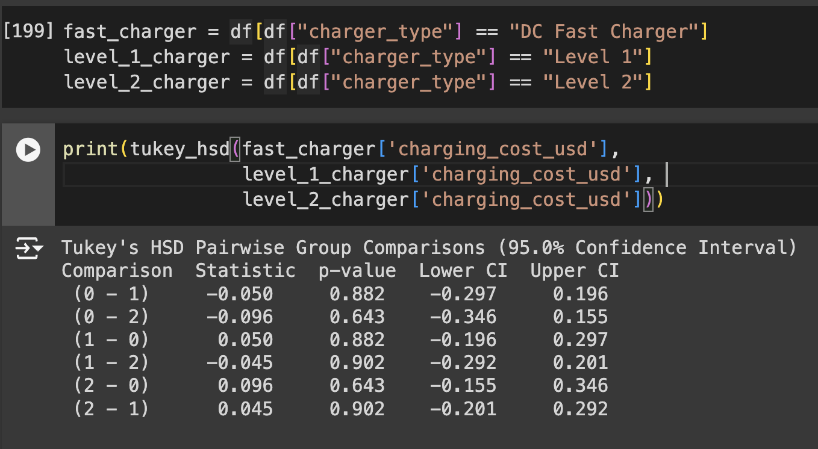
Tukey

Slide 6
Duncan’s New Multiple Range Test
Assumptions
Independent Samples
Normality
Homogenous Variances
Continuous Dependent Variable
2 Groups or More
H_0 : μ_i =μ _j
H_A : at least one μ_i =\= μ _j
​
Focuses on which specific group means are significantly different from one another. More powerful than Tukey’s if the number of groups of large, but the risk of a Type I error increases.

Slide 7
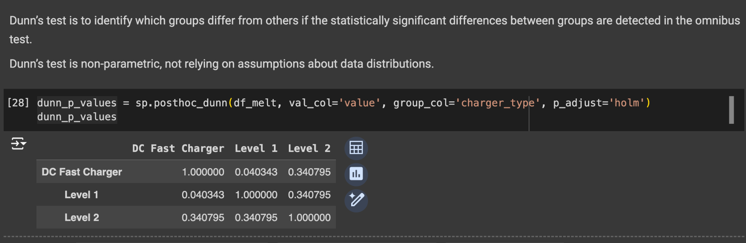
Dunn’s (Treatment vs a Control Group)

Slide 8
Scheffe’s Test
Assumptions
Independent Samples
Normality
Homogenous Variances
Continuous Dependent Variable
2 Groups or More
H_0 : μ_i =μ _j for all i, j
H_A : at least one μ_i =\= μ _j
​
Focuses on which specific group means are significantly different from one another. A very conservative model and can handle non-pairwise comparisons and controls the Type I Error. Less powerful than Tukey’s

Slide 9
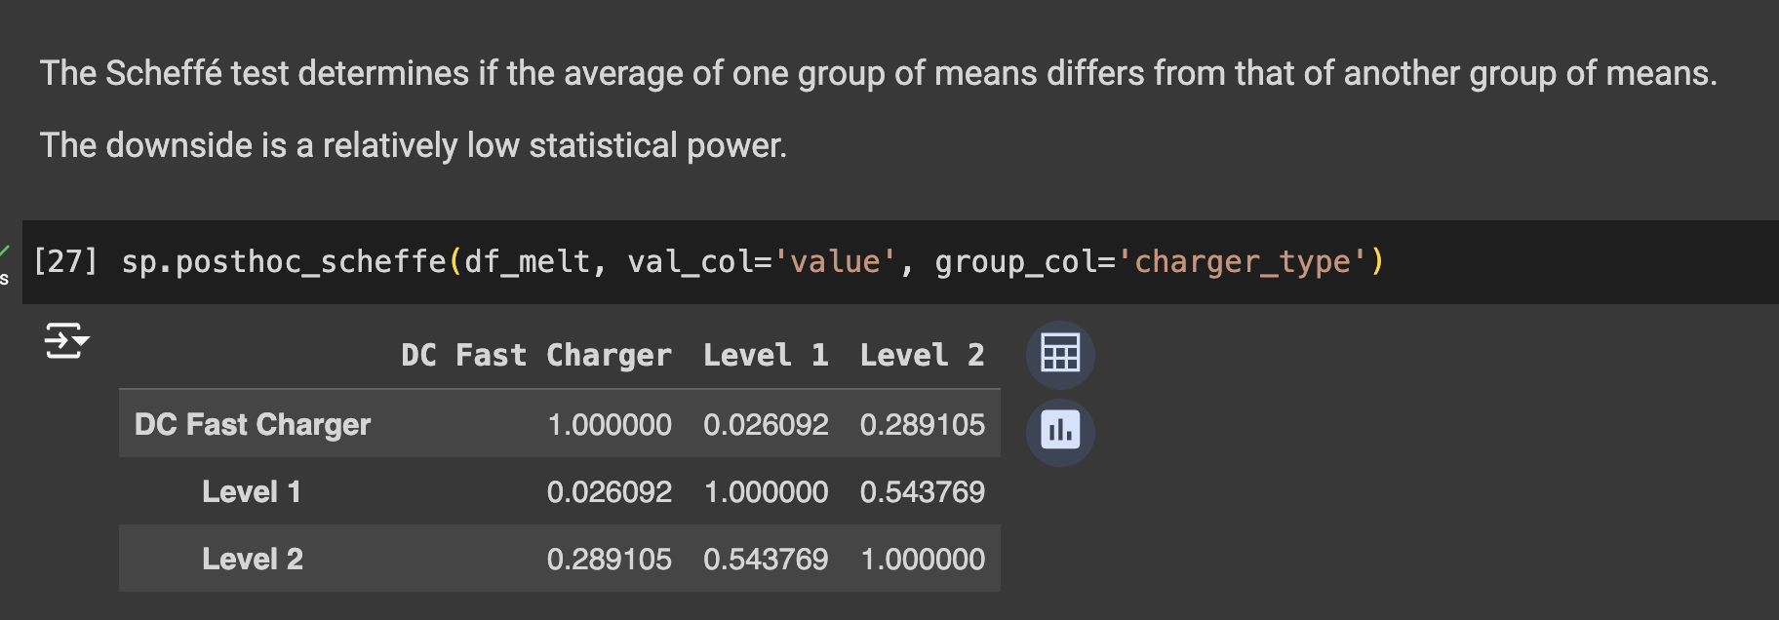
Scheffe

